Slide 1
Business Model Environment

Slide 2
Business Model and Its Relatives

Slide 3
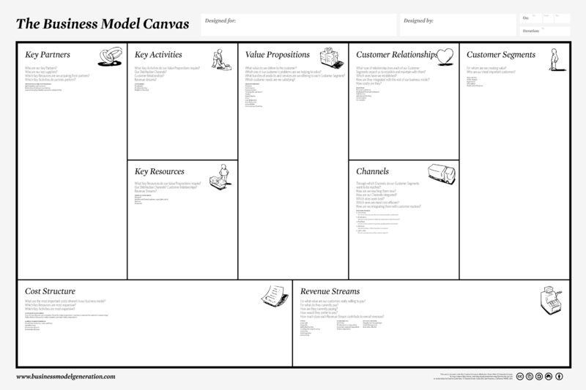
This is your Business Model Canvas…

Slide 4
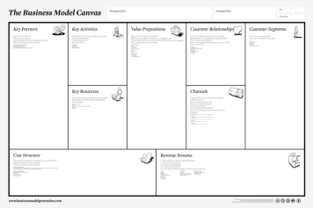
…but you’re not alone

Slide 5
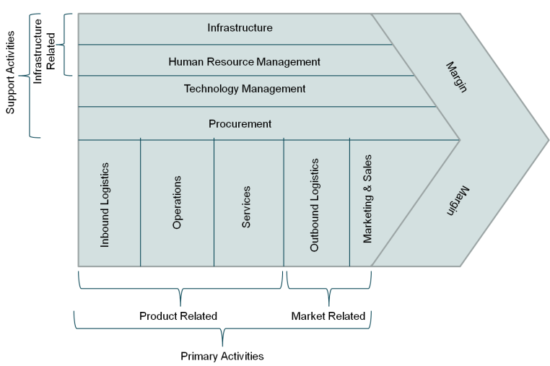
Business Model Relationships
Business Models form chains from materials to ultimate customer.
Commonly referred to as Value Chains (Porter).
Similar to Business Model Canvas, more process-oriented.

Slide 6
Connected Business Models share an environment

Slide 7
Business Environment Model (BME)
Business Environment Model Asks:
What factors external to your business will impact your success?
Which of these factors are key?
BME also:
Provides Context
A method to fully understand how external factors inform your business model and be a source of data for further iterations.
Identifies Design Drivers
A method to focus attention on the key elements of your business model that are critical to success.
Identifies Constraints
What parts of the environment create the highest barriers?
Notes:
Ties to each of the 9 Building Blocks of the Business Model Canvas.

Slide 8
Business Model Environment (Osterwalder)
Business Model
Key Trends
Market Forces
Macro-Economic Forces
Industry Forces
Technology
Regulatory
Societal and Cultural
Socioeconomic
Global Market Conditions
Capital Markets
Economic Infrastructure
Commodities
Suppliers
Stakeholders
Competitors
New Entrants
Substitutes
Market Segments
Needs and Demands
Market Issues
Switching Costs
Revenue Attractiveness

Slide 9
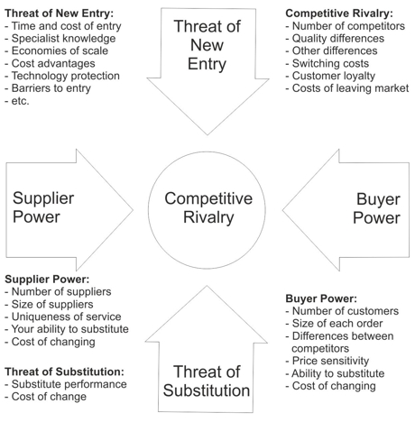
Business Model Environment (Porter)

Slide 10
What environmental factors did they exploit?

Slide 11
What environmental factors did they exploit?

Slide 12
What environmental factors did they exploit?

Slide 13
What environmental factors did they exploit?

Slide 14
What environmental factors did they exploit?

Slide 15
Business Environment Model Worksheet

Slide 16
Resources
Osterwalder & Pigneur, “Business Model Generation”
Blank & Dorf, “The Startup Owner’s Manual”
Porter, “Competitive Advantage” (Value Chain)
Porter, “Competitive Strategy” (Five Forces)
http://bmdesigner.com
http://bmfiddle.com
http://businessmodelhub.com
http://www.businessmodelalchemist.com
Business Model Canvas template on NVC web site
Steve Blank lectures: http://bit.ly/BlankLLP

